Slide 1
ASP.NET MVC 5 with Developement Patterns
WCF Services
Copyright © 2016 Adrian Ilewicz

Slide 2
Module agenda
What is Windows Communication Foundation
Kind of services
WCF ABCs
Using services

Slide 3
MVC Components
ROUTING
MODELS
CONTROLLERS
VIEWS
WCF
TESTS

Slide 4
Windows Communication Foundation
Service A
Client
Service Catalog
.NET Framework for building SOA applications
Service oriented architecture
Service B
Router
LB

Slide 5
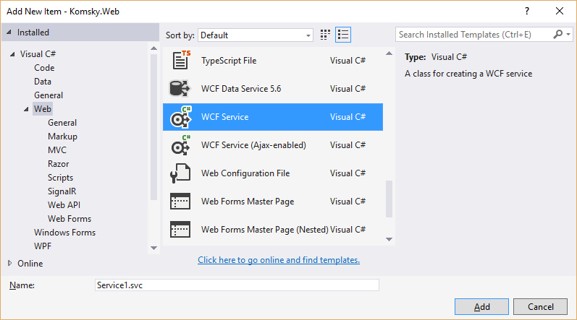
Kinds of Services
WCF
Classic SOAP
AJAX-Enabled
Data Service
Web API
REST

Slide 6
WCF ABC’s
A
Where
B
How
C
What
Address
what is the service location
Binding
what language does it use
Contract
what it can do
what operations and data does it expose

Slide 7
IIS .SVC Files
Simply activation point for a class
You create a service class, IIS host it for you
Provide .SVC class to tell IIS what class it must run

Slide 8
Using services
.SVC
Service reference
Channel Factory
jQuerys AJAX
You will need a service client

Slide 9
demo
Setting up WCF data service

Slide 10
AJAX-ENABLED WCF

Slide 11
Module summary
What is Windows Communication Foundation
Kind of services
WCF ABCs
Using services

Slide 12
Questions?
Fragen
Spurningar
Vragen
Pytania
Otázky

Copyright © 2016 Adrian Ilewicz

